Slide 1
EP408 Project Solar Wind Orbits
Hardeep Kaur Gill - 20705251

Slide 2
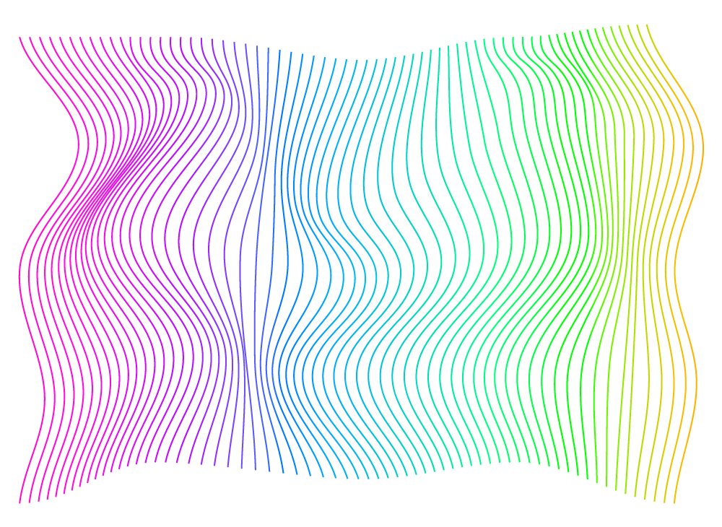
MINI - RESEARCH
A mini-research problem is a problem given to physics students to fill the gap between structured learning and studying a chaotic phenomenon to come up with a generalised principle.

Slide 3
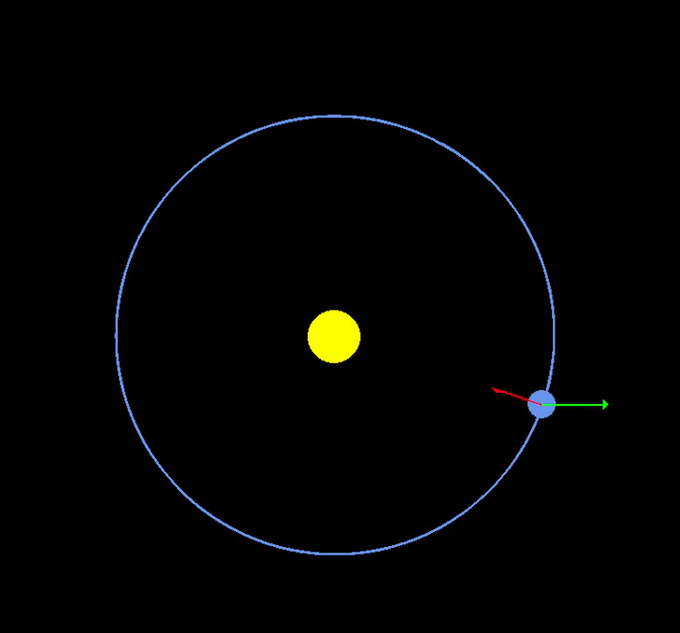
Solar Wind Orbit
Imagine a normal planetary system under the influence of gravity (red arrow). The problem is focusing on how a constant uniform force directed one way, would affect the orbit of a planet.

Slide 4


Theory: (forget solar wind)
01
Main force acting on planet:
$ma = \frac{GMm}{r^{2}}$ (1) Gravity.
01
Write (1) as a pair of dif. equations:
${\ddot{r}}_{1} = \frac{−r_{1}}{r^{3}}$ (2a)
${\ddot{r}}_{2} = \frac{−r_{2}}{r^{3}}$ (2b)

Slide 5


Theory: (remember solar wind)
If the r₁ axis is taken to lie in the direction of the uniform force, with magnitude k, then eqs (2) become:
${\ddot{r}}_{1} = \frac{−r_{1}}{r^{3}}$ (2a)
${\ddot{r}}_{2} = \frac{−r_{2}}{r^{3}}$ (2b)
${\ddot{r}}_{1} = \frac{−r_{1}}{r^{3}}+k$ (3a)
${\ddot{r}}_{2} = \frac{−r_{2}}{r^{3}}$ (3b)

Slide 6
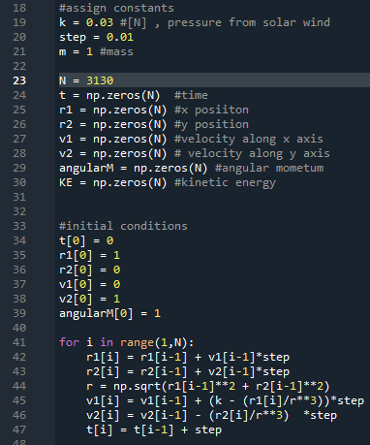
Code Implementation
Using Euler’s method, the eqs (3) were coded.
First, required variables are declared and then the for-loop block uses the previous velocity components to compute the new position components. It then computes the new velocities at that point and increases time by the step size.

Slide 7
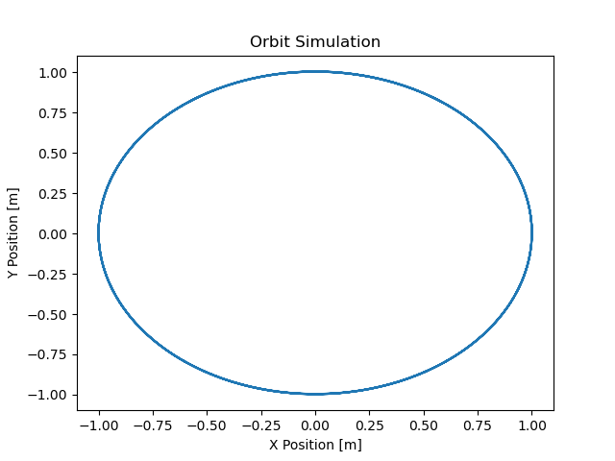
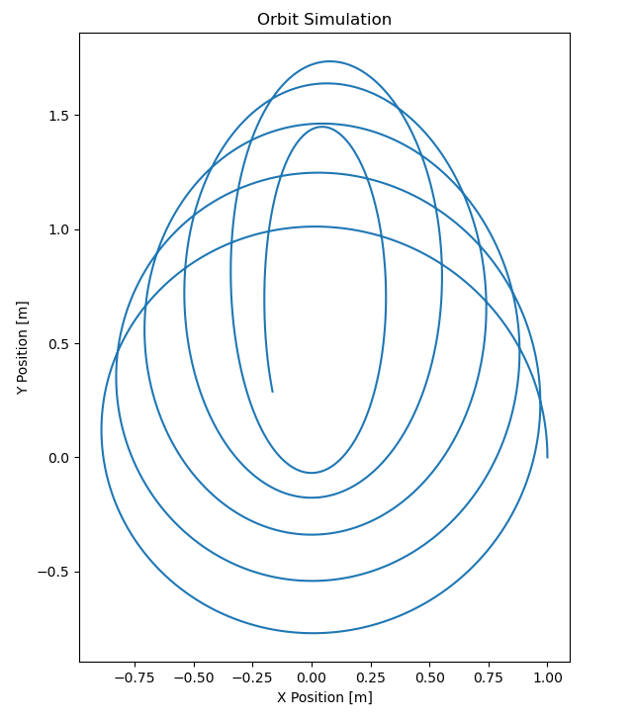
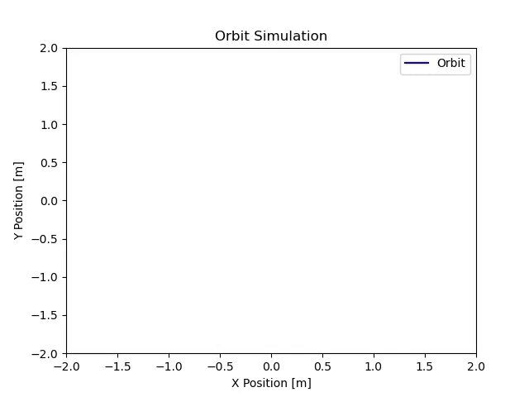
RESULTS
K = 0
K = 0.03
If k is set to zero, the orbit is unchanged. As soon as a slight pressure is applied to the orbit, it evolves and gets elongated exactly 90 degrees away from the uniform force, instead of in the same direction as the uniform force, as one would expect.

Slide 8
4 modes of analysis
01
03
02
04
An observational attack
A quantitative analysis
Compare different physical quantities of the system.
Think about the efficiency of the initial analysis.
A qualitative analysis
A quantum mechanical approach
Think about the effiency of the initial analysis.
Explore quantum mechanical implications of the problem.

Slide 9
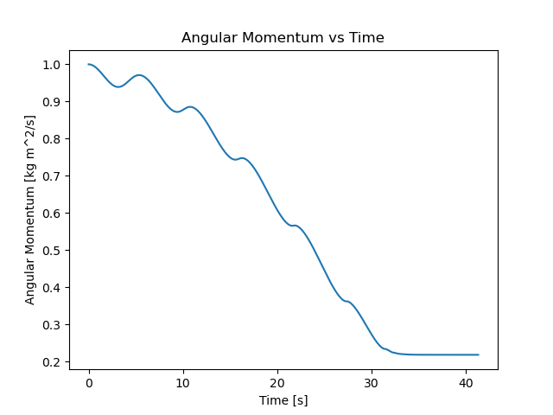
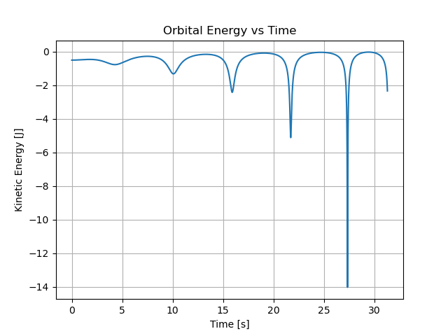

An observational attack

Slide 10
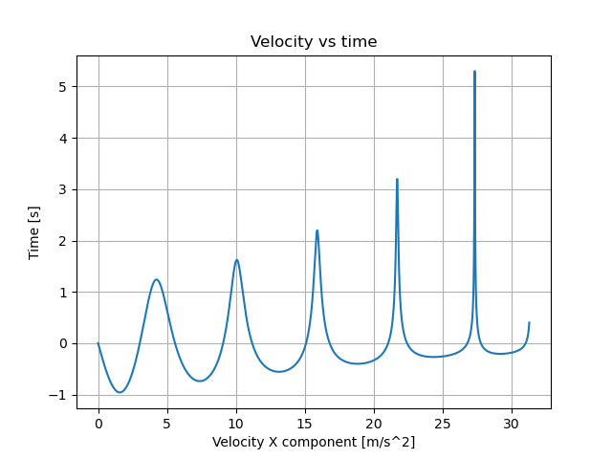
An observational attack
Tendency of speed trendline to move upwards is because of the external uniform force applied to the system.
Over time, the velocity seem to speed up where it aligns with the uniform force and slow down where it is not aligned. This then results in an elliptical orbit.

Slide 11




A quantitative analysis
There are 2 ways reduce errors in the code:
Use a different method like RK4, however, this would make the code extremely complicated making a major difference, according to Arthur (1973).
Recast the eqs (3) to include scaled time τ
$dt = r^{2} dτ$ (4)
So, updating eqs (3) we have:
${\frac{dr_{1}}{dτ} =v}_{1}r^{2}$ (5a)
${\frac{dr_{2}}{dτ} =v}_{2}r^{2}$ (5b)
$\frac{dv_{1}}{dτ} =−\frac{r_{1}}{r}+kr^{2}$ (5c)
${\frac{dv_{2}}{dτ} =\frac{−r_{2}}{r}}_{ }$ (5d)
${\frac{dt}{dτ} = }_{ }r^{2}$ (5e)
${\ddot{r}}_{1} = \frac{−r_{1}}{r^{3}}+k$ (3a)
${\ddot{r}}_{2} = \frac{−r_{2}}{r^{3}}$ (3b)

Slide 12
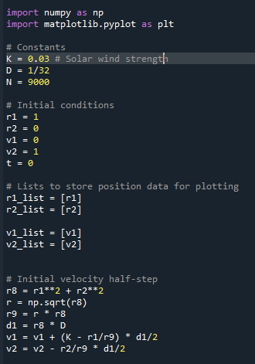
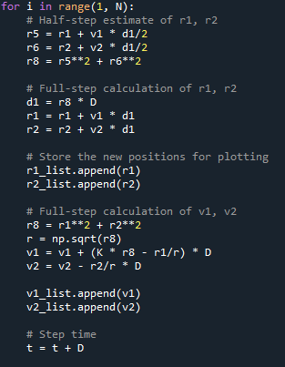
Code Implementation

Slide 13
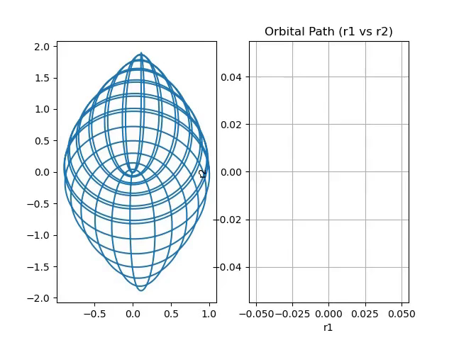
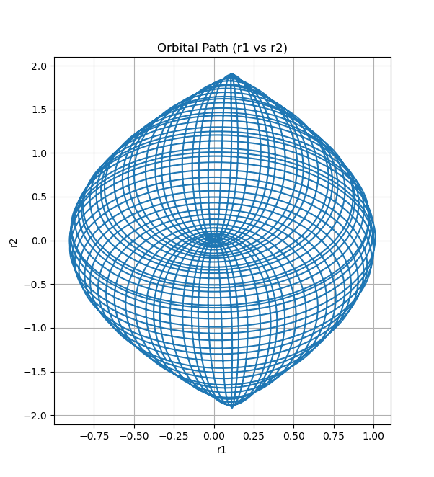
This picture shows a complete circle. Basically, an anti-clockwise orbit thins out in an elliptical orbit so much, it unwinds down to a sphere, again in a clockwise manner.
Three-fourths of the entire circle is shown in the picture. While the animation shows half of that.

Slide 14
MANY THANKS FOR YOUR ATTENTION!!
Any questions?

Slide 15
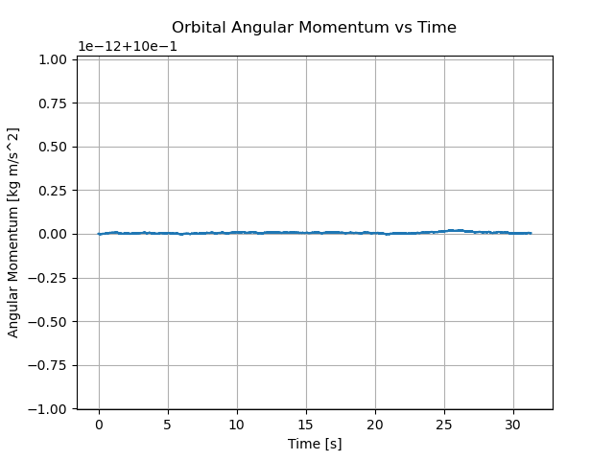
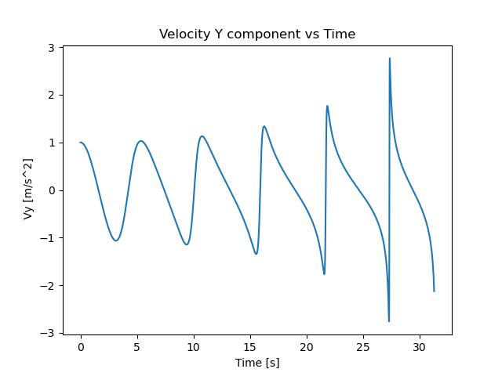
Appendix – Extra Information
Angular momentum when k= 0. This shows how angular momentum is preserved over time due to lack of non-conservative forces.
As the solar wind force is applied on the x direction of the orbit, the y component of the velocity is independent of the uniform force. Errors accumulate near the end of the stimulation.

